Slide 1
Real State Database Project
GROUP “C” MEMBERS
Yousef Alhaizaey
Luis R. Buitrago
Haotian Du
Ankur Panchal
Chunan Shen
Saurabh Shetty
Ning Tong
AGENDA
Introduction
Objective
Requirements & Assumptions
Database Structure
Prototypes Functionality

Slide 2
Real State Database Project
INTRODUCTION
To design and implement an Oracle database using the business rules and information proportioned in the class project documentation
OBJECTIVE
To apply the concepts and methodology learned in class complemented with the Oracle documents and software to create a new database for a Real State Agency

Slide 3
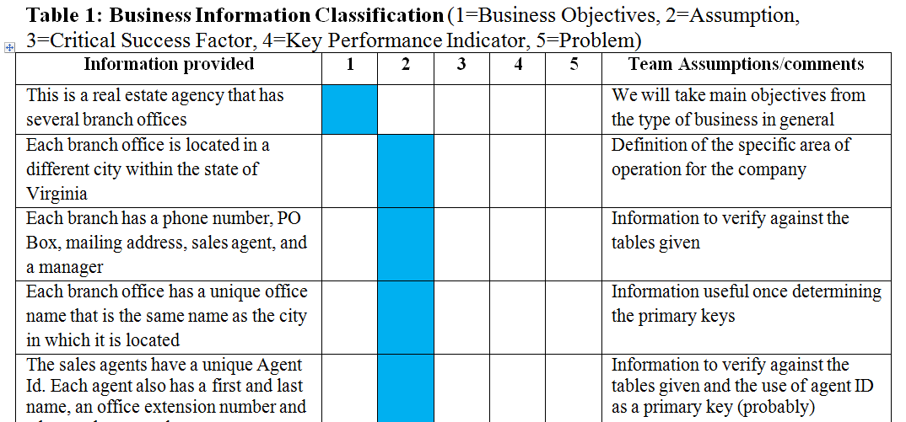
Real State Database Project
REQUIREMENTS & ASSUMPTIONS

Slide 4
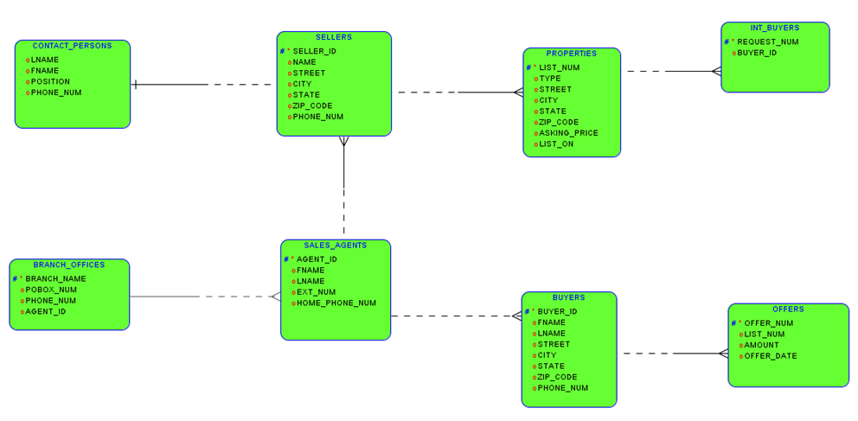
Real State Database Project
DATABASE STRUCTURE
Information Provided
Iterative process
Projection on Interfaces

Slide 5
Real State Database Project
WEBSITE PROTOTYPE
Customers Interface
Employees Interface
System Facility Interface
Leveled by users accessibility
Available at: http://www.blesolutions.com/wp-content/themes/bleSite.1.4.2/engineering.php

Slide 6
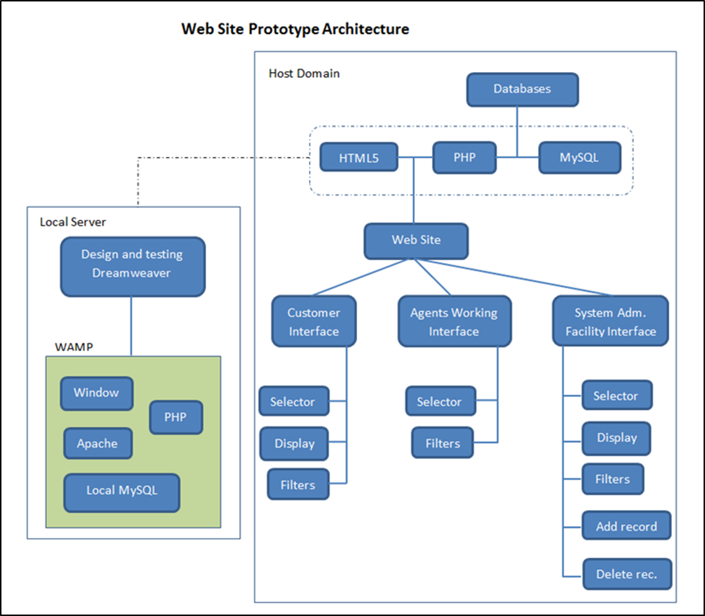
Real State Database Project

Slide 7
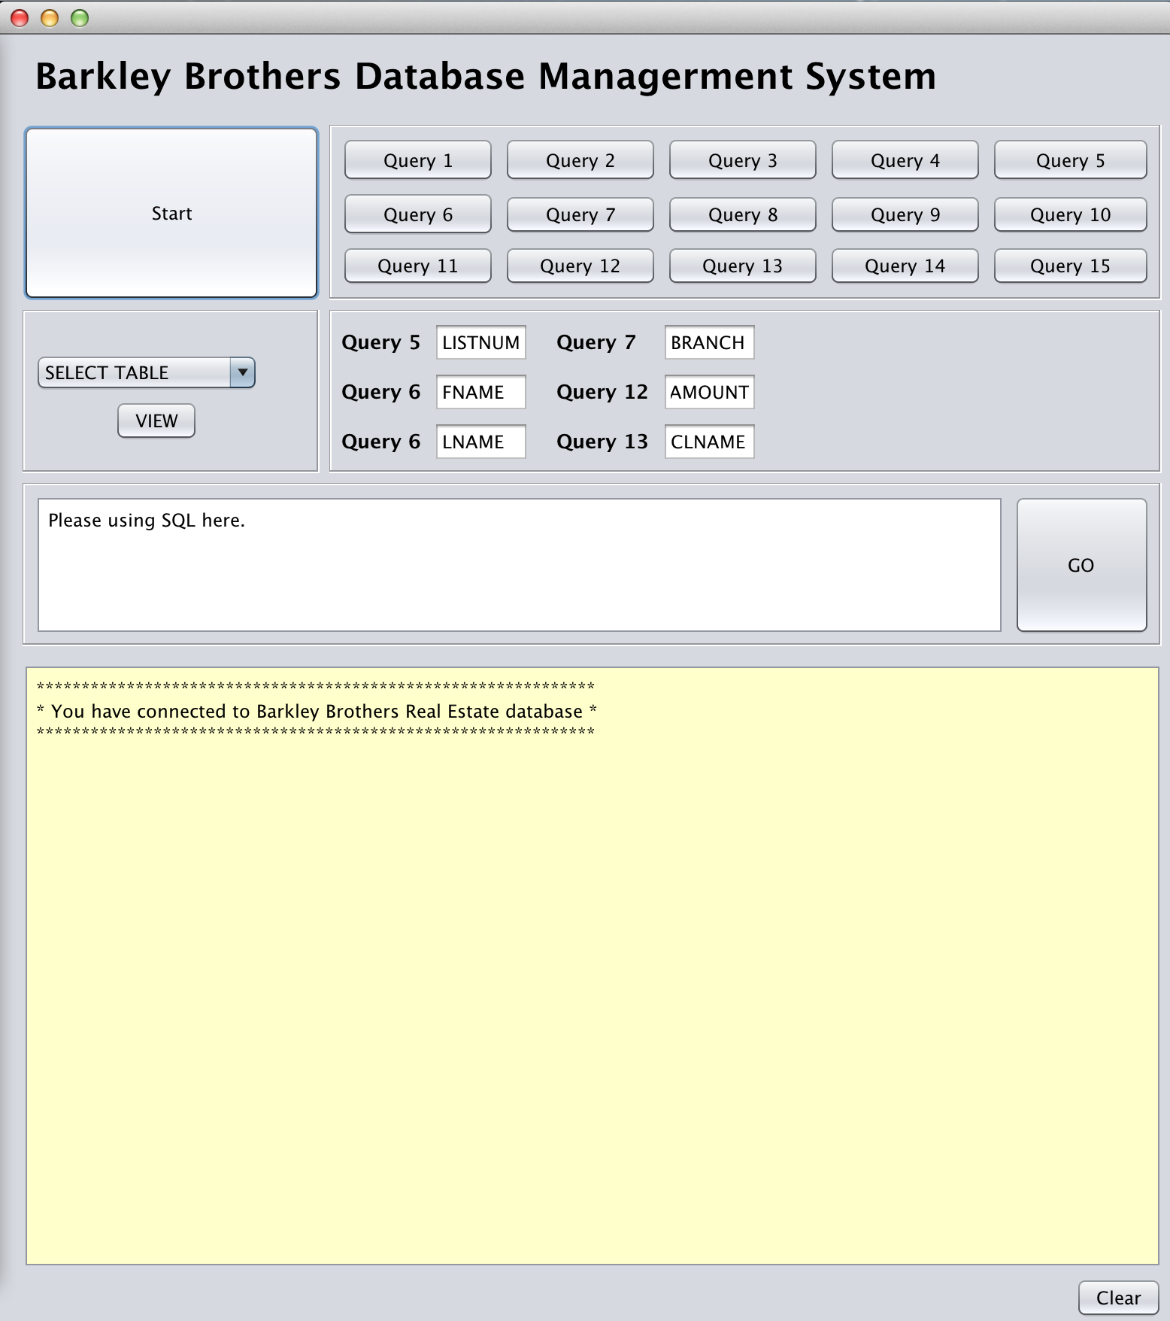
Real State Database Project
JAVA-GUI PROTOTYPE
Functionality
View existing table contents
Take users input and fast
execute built-in SQL queries
Write and execute SQL query

Slide 8
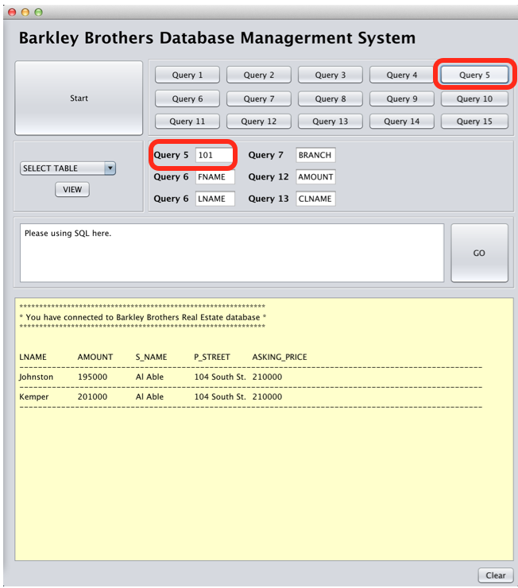
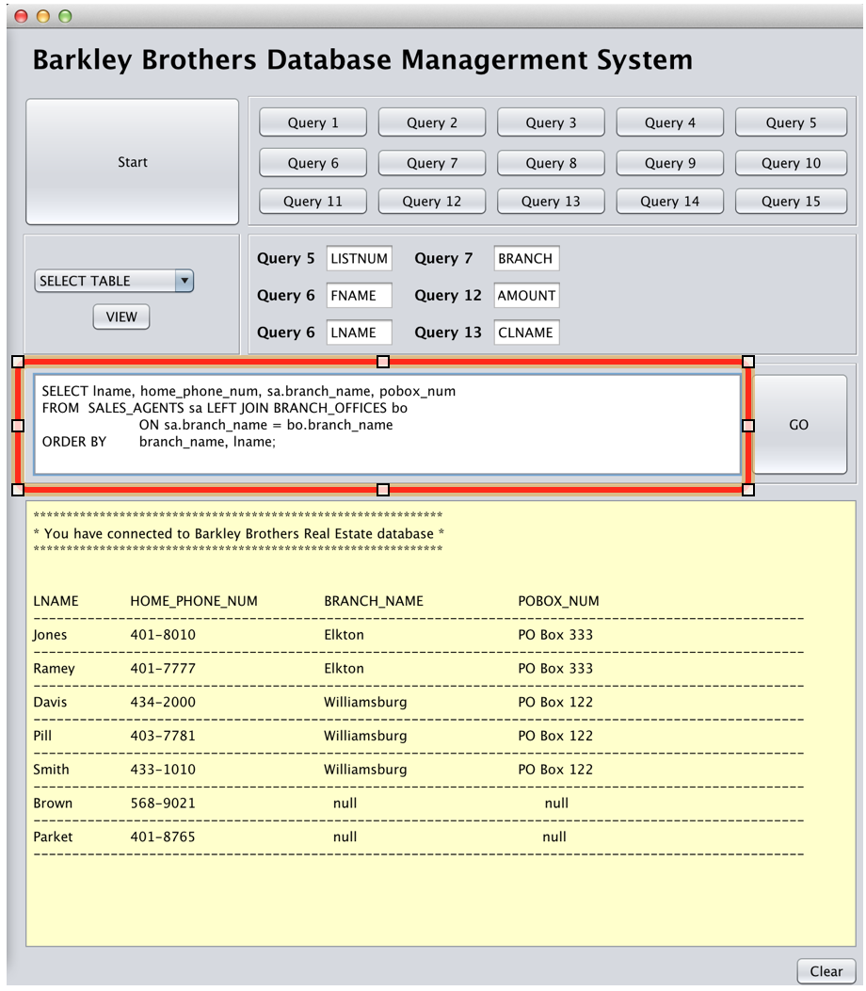
Real State Database Project
JAVA-GUI PROTOTYPE
Execute Built-in Queries
Execute SQL Queries

